Slide 1
Lecture 03
Introduction to
MapReduce and Spark
Csci E63 Big Data Analytics
Zoran B. Djordjević

Slide 2
Serial vs. Parallel Programming Model
Many or most of our programs are Serial.
A Serial Program consists of a sequence of instructions, where each instruction executes one after the other.
Serial programs run from start to finish on a single processor.
Parallel programming developed as a means of improving performance and efficiency.
In a Parallel Program, the processing is broken up into parts, each of which could be executed concurrently on a different processor. Parallel programs could be faster.
Parallel Programs could also be used to solve problems involving large datasets and non-local resources.
Parallel Programs are usually ran on a set of computers connected on a network (a pool of CPUs), with an ability to read and write large files supported by a distributed file system.

Slide 3
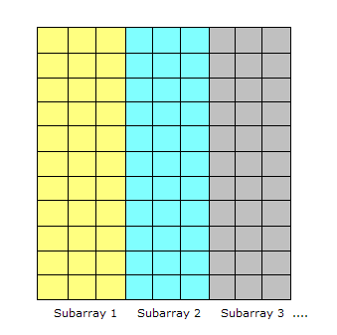
Common Situation
A common situation involves processing of a large amount of consistent data.
If the data could be decomposed into equal-size partitions, we could devise a parallel solution. Consider a huge array which can be broken up into sub-arrays
If the same processing is required for each array element, with no dependencies in the computations, and no communication required between tasks, we have an ideal parallel computing opportunity, the so called Embarrassingly Parallel problem.
A common implementation of this approach is a technique called Master/Worker.

Slide 4
MapReduce Programming Model
MapReduce programming model is derived as a technique for solving embarrassingly and not-so-embarrassingly parallel problems.
The idea stems from the map and reduce combinators in Lisp programming language.
In Lisp, a map takes as input a function and a sequence of values. It then applies the function to each value in the sequence. A reduce combines all the elements of a sequence using a binary operation. For example, it can use "+" to add up all the elements in the sequence.
MapReduce was developed within Google as a mechanism for processing large amounts of raw data, for example, crawled documents or web request logs.
http://static.googleusercontent.com/media/research.google.com/en//archive/mapreduce-osdi04.pdf
Google data is so large, it must be distributed across tens of thousands of machines in order to be processed in a reasonable time.
The distribution implies parallel computing since the same computations are performed on each CPU, but with a different portion of data.

Slide 5
MapReduce Library
map function, written by a user of the MapReduce library, takes an input key/value pair and produces a set of intermediate key/value pairs.
The MapReduce library groups together all intermediate values associated with the same intermediate key and passes them to the reduce function.
The reduce function, also written by the user, accepts an intermediate key and a set of values for that key. The reduce function merges together these values to form a possibly smaller set of values.

Slide 6
Vocabulary and Number of Words in all Documents
Consider the problem of counting the number of occurrences of each word in a large collection of documents
map(String documentName, String documentContent):
//key: document name, value: document content
for each word w in documentContent:
//key: word, value: number of occurances
EmitIntermediate(w, wordCount);
reduce(String w, Iterator values):
// key: a word, // values: a list of counts
int result = 0;
for each v in values:
result += v;
Emit(w, result));
The map function emits each word plus an associated count of occurrences in a document.
The reduce function sums all the counts for every word giving us the number of occurrances of each word in the entire set of documents.

Slide 7
MapReduce Programming Model, Again
Data types: key-value records (Keys and Values could be of different data types: ints, dates, strings, etc.)
Map function:
(K_{in}, V_{in}) ➔ list(K_{inter}, V_{inter})
Intermediate keys do not have to be related to the initial keys in shape or form.
Reduce function is fed sorted collection of intermediate values for each intermediate key.
(K_{inter}, list(V_{inter})) ➔ list(K_{out}, V_{out})
Reduce function transforms that collection into a final result, a list of key-value pairs.

Slide 8
MapReduce Execution
The Map invocations are distributed across multiple machines by automatically partitioning the input data into a set of M splits or shards.
The input shards can be processed in parallel on different machines.
reduce invocations are distributed by partitioning the intermediate key space into r pieces using a partitioning function (e.g., hash(key) mod r).
The number of partitions (r) and the partitioning function are specified by the user.

Slide 9
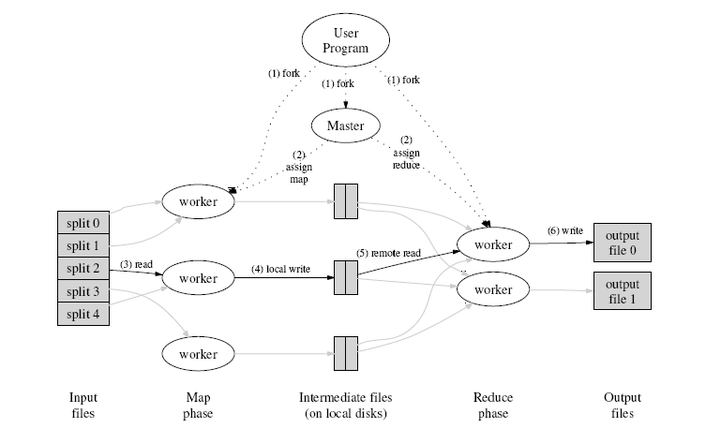
Flow of Execution

Slide 10
Open Source MapReduce
We will not build MapReduce frameworks.
We will learn to use an open source MapReduce Framework called Hadoop which is offered as Apache project, as well by commercial vendors: Cloudera, Hortonworks, MapR, IBM, and many other vendors.
Non commercial version of Hadoop source code is available at apache.org.
Each vendor improves on original, open source design and sells its improved version commercially.
Hadoop makes massive parallel computing on large clusters (thousands of cheap, commodity machines) possible.

Slide 11
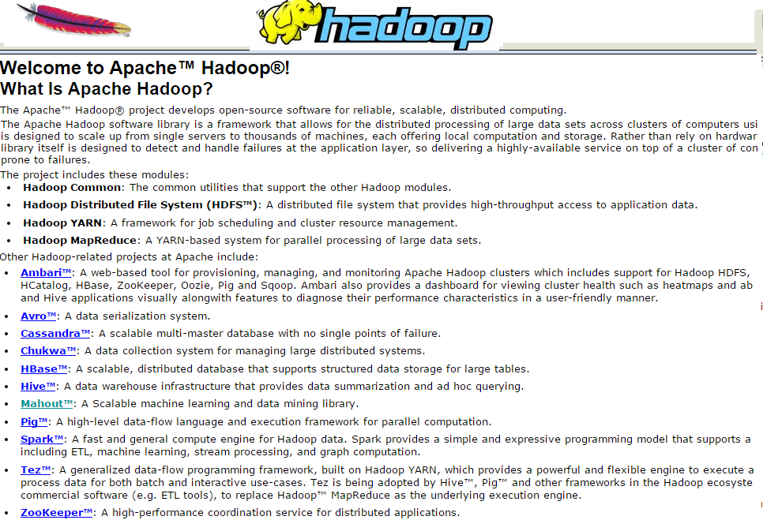
Hadoop could be fetched from hadoop.apache.org

Slide 12
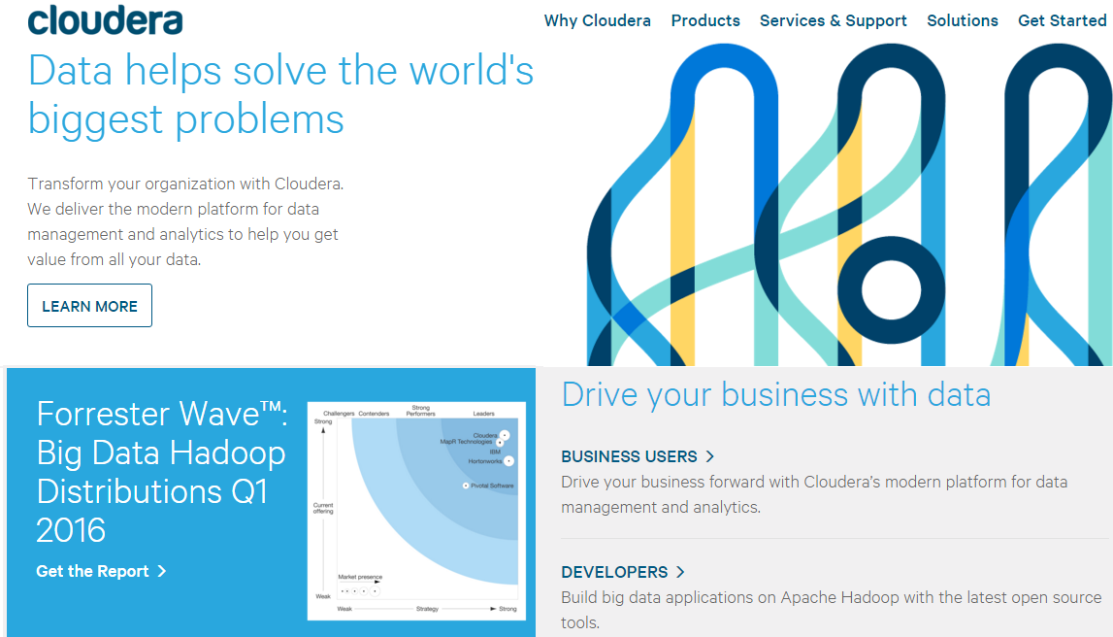
Cloudera
Doug Cutting who invented Hadoop is at Cloudera.

Slide 13

Hortonworks

Slide 14
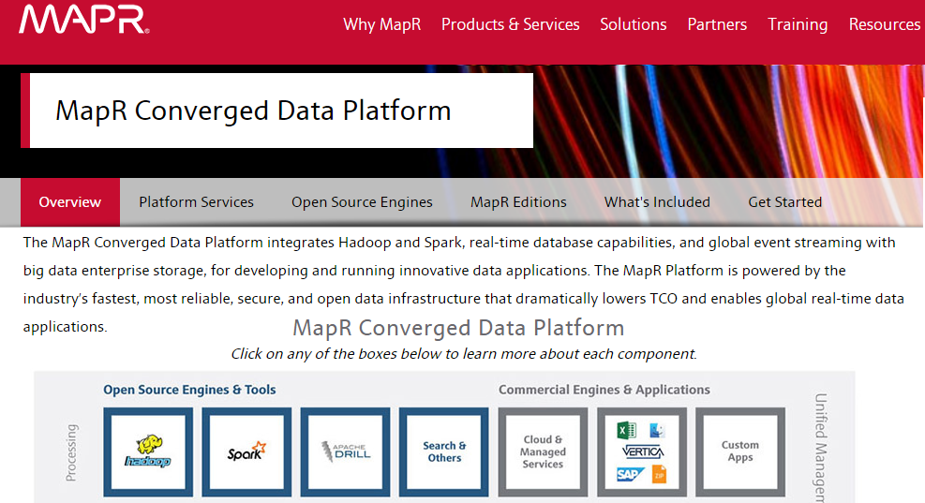
MapR
If you are the Government of India and want to store and use biometric information of 1.2 billion people, you use MapR Hadoop

Slide 15
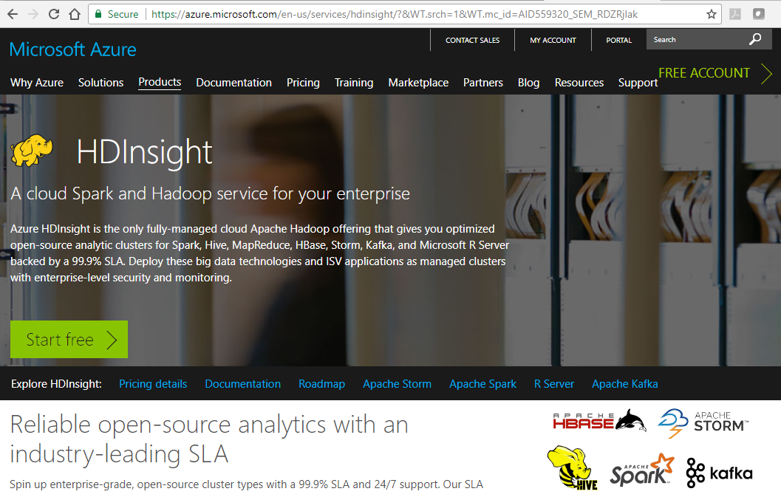
Microsoft Azure, HDInsight

Slide 16
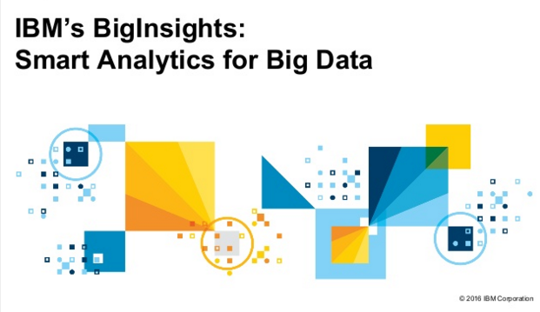
IBM BigInsight

Slide 17
References
Hadoop the Definitive Guide, 3rd Edition, by Tom White, O’Reilly 2012
Hadoop in Action, by Chuck Lam, Manning 2011
Hadoop in Practice, by Alex Holmes, Manning 2012
Cloudera, CDH5 Quick Start Guide

Slide 18
Lecture 03 Introduction to Spark
Zoran B. Djordjević

Slide 19
Reference
These slides follow to a good measure the book
"Learning Spark" by
Holden Karau, Andy Konwinski, Patrick Wendell & Mathei Zaharia, O’Reilly 2015

Slide 20

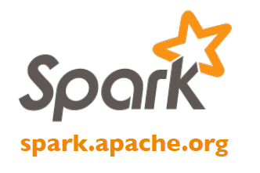
Spark
Spark is yet another one greatest thing ever invented.
Spark extends MapReduce model to efficiently support more types of computations, including interactive queries and stream processing.
Spark is designed to cover a wide range of workloads that previously required separate distributed systems, including batch applications, iterative algorithms, interactive queries, and streaming.
By supporting these workloads in the same engine, Spark makes it easy and inexpensive to combine different processing types.
Spark is designed to be highly accessible, offering simple APIs in Python, Java, Scala, R and SQL, and rich built-in libraries.
Spark integrates closely with other Big Data tools. Spark can run in Hadoop clusters and access any Hadoop data source, including NoSQL DBs like Cassandra.

Slide 21
What is Spark
Spark is an open-source software solution that performs rapid calculations on in-memory distributed datasets.
In-memory distributed datasets are referred to as RDDs
RDDs are Resilient Distributed Datasets
RDD is the key Spark concept and the basis for what Spark does
RDD is a distributed collections of objects that can be cached in memory across cluster and can be manipulated in parallel.
RDD could be automatically recomputed on failure
RDD is resilient – can be recreated on the fly from known state
Immutable – already defined RDDs can be used as a basis to generate derivative RDDs but are never mutated
Distributed – the dataset is often partitioned across multiple nodes for increased scalability and parallelism

Slide 22
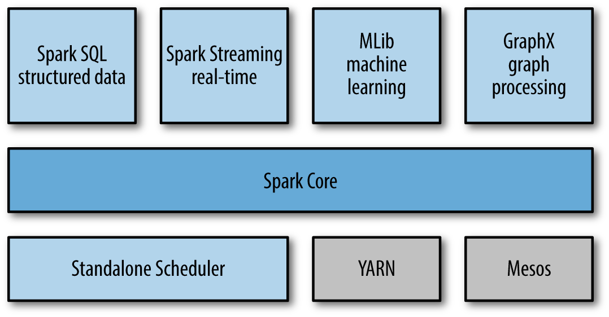
What is Spark
Spark is a fast general processing engine for large scale data processing
Spark is designed for iterative computations and interactive data mining.
Spark supports use of well known languages: Scala, Python, Java and R
With Spark streaming the same code could be used on data at rest and on data in motion
Spark has several key modules:

Slide 23
Key Modules
Spark Core contains the basic functionality of Spark, including components for task scheduling, memory management, fault recovery, interacting with storage systems, and others.
Spark Core is the home to the API that defines resilient distributed datasets (RDDs), which are Spark’s main programming abstraction.
RDDs represent a collection of items distributed across many compute nodes that can be manipulated in parallel. In recent releases less emphasis is placed on RDDs and more and DataFrames and Datasets.
Spark SQL is Spark’s package for working with structured data. I
Spark SQL allows querying data via SQL as well as the Apache Hive variant of SQL—Hive Query Language (HQL)—and it supports many sources of data, including Hive tables, Parquet, and JSON.
Spark SQL allows developers to intermix SQL queries with the programmatic data manipulations supported by RDDs and DataFrames in Python, Java, and Scala, all within a single application, thus combining SQL with complex analytics.

Slide 24
Key Modules
Spark Streaming is a Spark component that enables processing of live streams of data. Data streams include log files of web servers, or queues of messages.
Spark Streaming API for manipulating data streams closely matches the Spark Core’s RDD API, making it easy to move between apps that manipulate data in memory, on disk, or arriving in real time.
Spark Streaming provides the same degree of fault tolerance, throughput, and scalability as Spark Core.
MLlib is a library containing common machine learning (ML) functionality.
MLlib provides multiple types of machine learning algorithms, including classification, regression, clustering, and collaborative filtering, as well as supporting functionality such as model evaluation and data import.
MLlib provides some lower-level ML primitives, including a generic gradient descent optimization algorithm.
All of ML methods are designed to scale out across a cluster.

Slide 25
Key Modules
GraphX is a library for manipulating graphs (e.g., social network’s graphs) and performing graph-parallel computations.
GraphX extends the Spark RDD API, allowing us to create a directed graph with arbitrary properties attached to each vertex and edge.
GraphX also provides various operators for manipulating graphs (e.g., subgraph and mapVertices) and a library of common graph algorithms (e.g., PageRank and triangle counting).
Cluster Managers allow Spark to efficiently scale up from one to many thousands of compute nodes.
Spark can run over a variety of cluster managers, including Hadoop YARN, Apache Mesos, and a simple cluster manager included in Spark itself called the Standalone Scheduler.

Slide 26
How does Spark Work?
RDD
Your data is loaded in parallel into structured collections
Actions
Manipulate the state of the working model by forming new RDDs and performing calculations upon them
Persistence
Long-term storage of an RDD’s state
Spark Application is a definition in code of
RDD creation
Actions
Persistence
Spark Application results in the creation of a DAG (Directed Acyclic Graph)
Each DAG is compiled into stages
Each Stage is executed as a series of Tasks
Each Task operates in parallel on assigned partitions
It all starts with the SparkContext ‘sc’

Slide 27
SparkSession
In Spark 1.6, you have to create a SparkConf and SparkContext to interact with Spark, as shown here:
//set up the spark configuration and create contexts
val sparkConf = new SparkConf().setAppName("SparkSessionZipsExample").setMaster("local") // your handle to SparkContext to access other context like SQLContext
val sc = new SparkContext(sparkConf).set("spark.some.config.option", "some-value") val sqlContext = new org.apache.spark.sql.SQLContext(sc)
In Spark 2.0 the same effect will be achieved through SparkSession, without explicitely creating SparkConf, SparkContext or SQLContext, as they’re encapsulated within the SparkSession.
Using a builder design pattern, it instantiates a SparkSession object if one does not already exist, along with its associated underlying contexts.
// Create a SparkSession. No need to create SparkContext
// You automatically get it as part of the SparkSession
val warehouseLocation = "file:${system:user.dir}/spark-warehouse"
val spark = SparkSession .builder() .appName("SparkSessionZipsExample") .config("spark.sql.warehouse.dir", warehouseLocation) .enableHiveSupport() .getOrCreate()

Slide 28
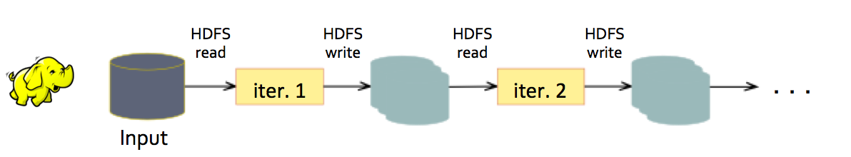
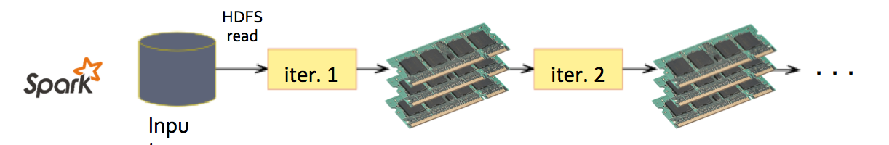
Spark vs. Map Reduce
Map Reduce places every result on the disk
Spark is much smarter, it keeps all results in memory
MapReduce greatly simplified big data analysis
But as soon as it got popular, users wanted more:
More complex, multi-pass analytics (e.g. ML, graph)
More interactive ad-hoc queries
More real-time stream processing
All need faster data sharing across parallel jobs

Slide 29
Data Sharing in Map Reduce
Map Reduce is slow due to replication, serialization and disk IO
HDFS read
HDFS write
HDFS read
HDFS write
iter. 1
iter. 2
. . .
Input
HDFS read
query 1
result 1
query 2
result 2
query 3
result 3
Input
. . .

Slide 30

Data Sharing in Spark
Distributed memory is 10-100× faster than network and disk
iter. 1
iter. 2
. . .
Input
query 1
one-time processing
query 2
query 3
Input
Distributed memory
. . .

Slide 31
Spark vs. Map Reduce
Spark extends the popular MapReduce model to efficiently support more types of computations, including interactive queries and stream processing.
It is said that inventors of Spark noticed that Hadoop (MapReduce) was inefficient for the iterative workflows and they extended Hadoop architecture to make it more efficient.
Speed is important in processing large datasets, as it means the difference between exploring data interactively and waiting minutes or hours.
Spark’s speed comes from its ability to run computations in memory. Spark appears to be more efficient than MapReduce for complex applications running on disk.
Spark retains the attractive properties of MapReduce:
fault tolerance, data locality, scalability

Slide 32
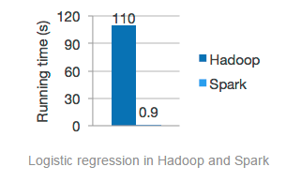
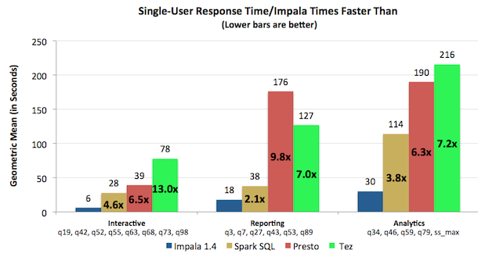
Spark vs. Hadoop
You will frequently see diagrams like this:
Do not take this diagrams as a sign of inferiority of people who developed Hadoop. Hadoop people will show you the results below which compare Impala, an SQL engine they developed and Spark. Impala is 4 or 6 X faster,….
Engineers who developed Hadoop are learning from Spark just like Spark developers learned from Hadoop.
Cycles keep repeating

Slide 33

Distributed Memory Processing
Just like MapReduce (Hadoop), Spark has a central controller, called Driver (App Master) which distributes tasks to Workers.
Data (RDD) is split among memories of many workers.
Data is originally sourced from the disk (HDFS, S3, regular File System). During processing is shared only between memories (if possible).
Driver, if it detects that a worker is slacking or not working at all could make the worker redo its work or could move processing to another worker.
Spark is fault tolerant just like Hadoop.
Cache 1
results
Worker
tasks
Block 1
Driver
Cache 2
Worker
Cache 3
Worker
Block 2
Block 3

Slide 34
Installation of Spark 2.2
Spark appears to be developed and run on Linux systems.
From Harvard’s Web Store (https://e5.onthehub.com/WebStore/Welcome.aspx?ws=4185a0dc-d0d1-e511-9416-b8ca3a5db7a1&vsro=8 ) download and install VMWare Workstation 12 or VMWare Fusion.
From CentOS.org get the latest (7.4) version of that OS. Choose Everything ISO.
Create a CentOS Virtual Machine. Besides the root user create one more user with administrative (sudo) privileges. It is convenient if that user and the root have the same password. Keep it that way, for now.
To see which CentOS release you have, type:
$ cat /etc/centos-release
7.4

Slide 35
Java
For Spark 2.2 to run you must have Java 1.8+ installed. On the command prompt of CentOS 7.4 OS, type:
$ java –version
1.8.0_131 # This is not the very latest but is good
To find where Java lives, type:
$ whereis java
/usr/lib/jvm ….
ls /usr/lib/jvm
java-1.7.0-openjdk-1.7.0.141-2.6.10.5.el7.x86_64
java-1.8.0-openjdk-1.8.0.131-11.b12.el7.x86_64
In file /etc/bashrc or in file .bash_profile in your home directory add lines:
JAVA_HOME=/usr/lib/jvm/java-1.8.0-openjdk-1.8.0.131-11.b12.el7.x86_64/jre
export $JAVA_HOME
PATH=$PATH:$JAVA_HOME/bin
export $PATH

Slide 36
Python
Spark 2.2 needs Python 2.7+ or 3.4+. On the command prompt, type:
$ python
2.7.6 # this is good enough
You need pip utility, if it is not already there:
sudo yum install python-pip
sudo pip install --upgrade pip
sudo yum install python-wheel
sudo pip install pyspark

Slide 37
Scala
Spark 2.2 needs Scala 2.11+
Do the following:
$ sudo curl https://bintray.com/sbt/rpm/rpm > /etc/yum.repos.d/bintray-sbt-rpm.repo
$ sudo mv bintray-sbt-rpm.repo /etc/yum.repos.d/
$ sudo yum install sbt
$ sbt

Slide 38
Scala Programming Language (from Wikipedia)
Scala (/ˈskɑːlə/ SKAH-lə) is an object-functional programming language for general software applications. Scala has full support for functional programming and a very strong static type system. This allows programs written in Scala to be very concise and thus smaller in size than other general-purpose programming languages. Many of Scala's design decisions were inspired by criticism of the shortcomings of Java.
Scala source code is intended to be compiled to Java bytecode, so that the resulting executable code runs on a Java virtual machine. Java libraries may be used directly in Scala code and vice versa. Like Java, Scala is object-oriented, and uses a curly-brace syntax reminiscent of the C programming language. Unlike Java, Scala has many features of functional programming languages like Scheme, Standard ML and Haskel, including currying, type inference, immutability, lazy evaluation, and pattern matching. It also has an advanced type system supporting algebraic data types, covariance and contravariance, higher-order types, and anonymous types. Other features of Scala not present in Java include operator overloading, optional parameters, named parameters, raw strings, and no checked exceptions.
Functional programming is a subset of declarative programming. Programs written using this paradigm use functions, blocks of code intended to behave like mathematical functions. Functional languages discourage changes in the value of variables through assignment, making a great deal of use of recursion instead.

Slide 39
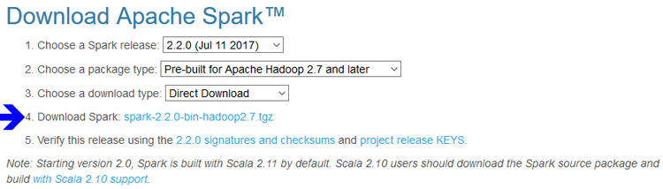
Install Spark 2.2
From the site: spark.apache.org select:
Download Spark to your home directory
$ cd ~
$ wget https://d3kbcqa49mib13.cloudfront.net/spark-2.2.0-bin-hadoop2.7.tgz
Unpack Spark in the /opt directory
$ sudo tar zxvf spark-2.2.0-bin-hadoop2.7.tgz -C /opt
Create a symbolic link to make it easier to access
$ sudo ln -fs spark-2.2.0-bin-hadoop2.7 /opt/spark

Slide 40
Setup the Environment
To complete your installation, set the SPARK_HOME environment variable so it takes effect when you login to your VM.
Insert these lines into your ~/.bash_profile:
export SPARK_HOME=/opt/spark
PATH=$PATH:$SPARK_HOME/bin
export PATH
Then exit the text editor and return to the command line.
You need to reload the environment variables (or logout and login again) so they take effect.
$ source ~/.bash_profile
Confirm that spark-submit is now in the PATH.
$ spark-submit --version
# (Should display a version number)

Slide 41
Spark Shells
Spark comes with interactive shells that enable ad hoc data analysis.
Unlike most other shells, which let you manipulate data using the disk and memory on a single machine, Spark’s shells allow interaction with data distributed on disks or in memory across many machines.
Spark can load data into memory on the worker nodes, and distributed computations, even ones that process large volumes of data across many machines, can run in a few seconds. This makes iterative, ad hoc, and exploratory analysis commonly done in shells a good fit for Spark.
Spark provides both (and only) Python and Scala shells that have been augmented to support access to a cluster of machines.
In these lecture notes, we will use Python shell, only.
Python shell opens with pyspark command.
Scala shell is very similar and opens with spark-shell command.
You can program Spark from R using package SparkR

Slide 42
pyspark
If you type pyspark on the Linux command prompt, you will see the following:
[cloudera@localhost conf]$ pyspark
Python 2.7.6 (r266:84292, Jul 23 2017, 15:22:56)
[GCC 4.4.7 20120313 (Red Hat 4.4.7-11)] on linux2
Type "help", "copyright", "credits" or "license" for more information.
SLF4J: Class path contains multiple SLF4J bindings.
SLF4J: Found binding in [jar:file:/usr/lib/zookeeper/lib/slf4j-log4j12-1.7.5.jar!/org/slf4j/impl/StaticLoggerBinder.class]
SLF4J: Found binding in [jar:file:/usr/lib/flume-ng/lib/slf4j-log4j12-1.7.5.jar!/org/slf4j/impl/StaticLoggerBinder.class]
SLF4J: See http://www.slf4j.org/codes.html#multiple_bindings for an explanation.
SLF4J: Actual binding is of type [org.slf4j.impl.Log4jLoggerFactory]
Welcome to
____ __
/ __/__ ___ _____/ /__
_\ \/ _ \/ _ '/ __/ '_/
/__ / .__/\_,_/_/ /_/\_\ version 2.2.0
/_/
Using Python version 2.7.6 (r266:84292, Jul 23 2017 15:22:56)
SparkContext available as sc, HiveContext available as sqlContext.
>>>

Slide 43
Shell verbosity and log4j.properties file
The output is long and annoying. It would have been even longer had we not created log4j.properties file in the directory $SPARK_HOME/conf.
You create that file by copying provided file log4j.properties.template and by changing line
log4j.rootCategory=INFO, console
to read:
log4j.rootCategory=ERROR, console
That lowered the logging level so that we see only the ERROR messages, and above. Another option is WARN, which is more verbose that ERROR but less than INFO.
Before we proceed, let us see which files with how many lines we have in HDFS
$ hadoop fs –ls ulysses
-rw-r--r-- 1 cloudera 5258688 2015-04-01 14:32 input/4300.txt
$ hadoop fs -cat ulysses/4300.txt | wc
33056 267980 1573079

Slide 44
Load Data (RDD)
In Spark, we express our computation through operations on distributed collections that are automatically parallelized across the cluster.
These collections are called resilient distributed datasets, or RDDs.
When we load some data, i.e. a file into a shell variable, we are creating an RDD, like
>>> lines = sc.textFile("ulysses/4300.txt")
>>> lines.count()
33056
What we’ve just done is create and populate an RDD named lines using a mysterious object "sc" and its method textFile(). We populated that RDD with data in file ulysses/4300.txt.
"sc" stands for an implicit SparkContext. SparkContext allows us to communicate with the execution environment.
It appears that RDD-s are also (Object Oriented) objects and have methods, such as count()which gave use the exact number of lines in file 4300.txt.

Slide 45
Load Data (RDD) from Local File
We could load the same data from the local operating system.
We happen to have the 4300.txt file in /home/cloudera directory and could do the following:
>>> blines = sc.textFile("file:///home/cloudera/4300.txt")
>>> blines.count()
33056
>>> blines.first()
u'The Project Gutenberg EBook of Ulysses, by James Joyce'
What we did above was create an RDD named blines and populate that RDD with data from the local file /home/cloudera/4300.txt.
We also see in action another method of RDD-s, first(), which tells us that the first line in RDD blines is some uninterested collection of characters (u'').
Please note that we are not terminating our commands with a semi-colon (";") or anything else aside from the carriage return. Savings on typing all those semi-colons is one of the greatest contributions of Python to the computer science.
By the way, our commands are in Python.

Slide 46
Load Data (RDD) from the Cloud (AWS S3 Bucket)
I uploaded the same 4300.txt file to the Amazon’s AWS S3 bucket called zoran001.
On my Linux box (Cloudera VM) I created two new environmental variables in file .bash_profile.
AWS_ACCESS_KEY_ID=ADTSDYSDUIOSIDOI and
AWS_SECRET_ACCESS_KEY=dsfsfuierfsdfuiorfarifaifaopopa
I source the file:
$ source .bash_profile
Then, after reopening Python Spark shell, I issued the command:
>>> s3lines = sc.textFile("s3n://zoran001/4300.txt")
>>> s3lines.count()
33056
We did not loose a single line of text while brining the text down from the Cloud.
>>> Heaven = s3lines.filter(lambda line: "Heaven" in line)
>>> Heaven.count()
2
>>> heaven = s3lines.filter(lambda line: "heaven" in line)
>>> heaven.count()
50
We also see in action another method of RDD-s, filter(), which apparently let us inquire how many times is heaven mentioned in the ulysses. Heaven is mentioned 52 time, i.e. some 0.15% of the time (> Bible)
If you do not have an AWS account, do filtering examples on local files.

Slide 47
Python lambda Syntax
Python supports the creation of anonymous inline functions (i.e. functions that are not bound to a name) at runtime, using a construct called "lambda".
The following code shows the difference between a normal function definition ("f") and a lambda function ("g"):
>>> def f(x): return x**2
>>> print f(8)
64
>>> g = lambda x: x**2
>>> print g(8)
64
As you can see, f() and g() do exactly the same thing. The lambda definition does not include a "return" statement. The last expression is returned.
You can put a lambda definition anywhere a function is expected, and you don't have to assign it to a variable at all.

Slide 48
filter() Method
Method filter() takes a function returning True or False and applies it to a sequence (list) and returns only those members of the sequence for which the function returned True.
So, in the Python code :
heavens = s3lines.filter(lambda line: "Heaven" in line)
Method filter() acts on the collection s3lines, and passes every element of that collection as the variable line as the argument to the anonymous function created using lambda construct. That anonymous function uses a simple regular expression to test whether string "Heaven" exists in variable line. If the regular expression returns True for a particular line, an element of collection s3lines, the anonymous function will return True and for that particular line, filter() will return/add variable line building up a new collection called heavens.
You can accomplish the same in Java 1.7 and older with several lines of code. In Java 1.8 you have similarly efficient lambda constructs.

Slide 49
Passing Function to Spark in Python
We want to convince ourselves that rather than using lambda constructs we could define functions and then pass their names to Spark. For example:
>>> def hasLife(line):
. . . return "life" in line # At the beginning hit a tab
. . .
>>> lines = sc.textFile("file:///home/cloudera/4300.txt")
>>> lifeLines = lines.filter(hasLife)
>>> lifeLines.count()
203
>>> print lifeLines.first()
u'whom Mulligan was one, and Arius, warring his life long upon the'
>>>
Function hasLife() returns True if the line of text in its argument contains string "life". We successfully passed that function’s name to method filter().
Above, we have seen a few more crucial features of Python. Python accepted the second line of function definition only when we properly indented 'return "life"… statement.
Also, to terminate function definition, we had to hit Carriage Return (Enter) twice.
Most importantly, there are no semicolons in sight.

Slide 50
Passing Function in Java
In Java Spark API it is possible to pass functions as well. In that case, functions are defined as Java classes, implementing a Spark interface: org.apache.spark.api.java.function.Function.
For example:
JavaRDD<String> lifeLines = lines.filter(
new Function<String, Boolean>() {
Boolean call(String line){return line.contains("life");}
}
);
Java 8 introduces shorthand syntax called lambdas that looks similar to Python.
The above code in that lambda syntax would look like:
JavaRDD<String> lifeLines = lines.filter(line -> line.contains("life"));
A lot of Spark’s magic is in the fact that function-based operations like filter() also parallelize across the cluster. That is, Spark automatically takes your function (e.g., line.contains("Python")) and ships it to executor nodes.
You write code in a single driver program and Spark automatically has parts of it running on multiple nodes

Slide 51
Spark Sources and Destinations of Data
Spark supports a wide range of input and output sources, partly because it builds on the ecosystem made available by Hadoop.
In particular, Spark can access data through the InputFormat and OutputFormat interfaces used by Hadoop MapReduce, which are available for many common file formats and storage systems (e.g., S3, HDFS, Cassandra, HBase, etc.).
For data stored in a local or distributed file system, such as NFS, HDFS, or Amazon S3, Spark can access a variety of file formats including Text, JSON, SequenceFiles, and Google’s Protocol Buffers.
The Spark SQL module, provides an efficient API for structured data sources, including JSON and Apache Hive.
Spark could also use third-party libraries for connecting to Cassandra, HBase, Elasticsearch, and JDBC databases.
We will analyze some of the above techniques a bit later.

Slide 52
File Formats
Spark makes it very simple to load and save data in a large number of file formats. Spark transparently handles compressed formats based on the file extension.
We can use both Hadoop’s new and old file APIs for keyed (or paired) data. We can use those only with key/value data.
Format Name | Structured | Comments
Text File | No | Plain old text files. Records assumed to be one per line.
JSON | Semi | Common text-based format, semi-structured; most libraries require one record per line.
CSV | YES | Very common text-based format, often used with spreadsheet applications.
SequenceFile | YES | A common Hadoop file format used for key/value data
Protocol buffer | YES | A fast, space-efficient multi-language format
Object file | YES | Useful for saving data from a Spark job to be consumed by shared code. Breaks if you change your classes, as it relies on Java Serialization.

Slide 53
Standalone Applications
Spark can be linked into standalone applications in either Java, Scala, or Python. The main difference from using it in the shell is that you need to initialize your own SparkContext. After that, the API is the same.
The process of linking to Spark varies by language. In Java and Scala, you give your application a Maven dependency on the spark-core artifact.
Maven is a popular package management tool for Java-based languages that lets you link to libraries in public repositories. You can use Maven itself to build your project, or use other tools that can talk to the Maven repositories, including Scala’s sbt tool or Gradle.
Eclipse also allows you to directly add a Maven dependency to a project.
In Python, you simply write applications as Python scripts, but you must run them using the bin/spark-submit script included in Spark. The spark-submit script includes the Spark Python dependencies.
We simply run your script with the
$SPARK_HOME/bin/spark-submit your_script.py

Slide 54
Standalone Application in Python
To create an application (Python script) we need to import some Python classes and create SparkContext object.
The rest of the application is coded as if you are writing code in PySpark shell
from pyspark import SparkConf, SparkContext
conf = SparkConf().setMaster("local").setAppName("MyApp")
sc = SparkContext(conf = conf)
lines = sc.textFile("/ulysses/4300.txt")
lifeLines = lines.filter(lambda line: "life" in line)
print lifeLines.first()
If we invoke the above with:
$ spark-submit my_script.py
We get:
py4j.protocol.Py4JJavaError: An error occurred while calling o25.partitions.
: org.apache.hadoop.mapred.InvalidInputException: Input path does not exist: hdfs://localhost:8020/ulysses/4300.txt

Slide 55
Python Applications use full HDFS path
Apparently, we need to provide the complete HDFS path to our files and the filter() line of the script should read:
lines = sc.textFile("/user/cloudera/ulysses/4300.txt")
or
lines = sc.textFile("hdfs:///user/cloudera/ulysses/4300.txt")
If you recall, in HDFS, every user has a home directory, /user/cloudera in our case.
Modified script will produce the expected output:
$ spark-submit your_script.py
whom Mulligan was one, and Arius, warring his life long upon the
If we want to read 4300.txt file from the local Linux directory /home/cloudera, we should change the above line to:
lines = sc.textFile("file:///home/cloudera/4300.txt")

Slide 56
Initializing SparkContext object
To initialize SparkContext in Scala we would write:
import org.apache.spark.SparkConf
import org.apache.spark.SparkContext
import org.apache.spark.SparkContext._
val conf = new SparkConf().setMaster("local").setAppName("MyApp")
val sc = new SparkContext(conf)
To initialize SparkContext in Java we would write
import org.apache.spark.SparkConf;
import org.apache.spark.api.java.JavaSparkContext;
SparkConf conf = new SparkConf().setMaster("local").setAppName("MyApp");
JavaSparkContext sc = new JavaSparkContext(conf);
To initialize SparkContext in Python we did:
from pyspark import SparkConf, SparkContext
conf = SparkConf().setMaster("local").setAppName("MyApp")
sc = SparkContext(conf = conf)
Only one SparkContext may be active per JVM.
You must stop() the active SparkContext before creating a new one. To shutdown SparkContext call sc.stop() or exist the application with System.exit() or sys.exit()

Slide 57
Initializing SparkContext
Previous examples show the minimal way to initialize a SparkContext, where we pass two parameters:
cluster URL, namely local in these examples, which tells Spark how to connect to a cluster. local is a special value that runs Spark on one thread on the local machine, without connecting to a cluster.
an application name, namely MyApp in these examples. This will identify your application on the cluster manager’s UI if you connect to a cluster.
Additional parameters exist for configuring how your application executes or add code to be shipped to the cluster.
SparkContext is the main entry point for Spark functionality.

Slide 58
SparkContext Object
SparkContext represents the connection to a Spark cluster, and can be used to create RDDs, accumulators and broadcast variables on that cluster.
SparkContext comes with a large number of methods. As you can see from their names in Scala implementation, those methods implement large area of data processing and data manipulation functionality:
filter(), first(), flatMapValues(), fold(), foldByKey(), foreach(), foreachPartition(), fullOuterJoin(), getCheckpointFile(), getStorageLevel(), glom(), groupBy(), groupByKey(), groupWith(), histogram(), id(), isCheckpointed(), join(), keyBy(), keys(), leftOuterJoin(), lookup(), map(), mapPartitions(), mapPartitionsWithIndex(), mapValues(), max(), mean(), meanApprox(), min(), name(), set(), pipe(), randomSplit(), reduce(), reduceByKey(), reduceByKeyLocally(), repartition(), repartitionAndSortWithinPartitions(), rightOuterJoin(), sample(), sampleByKey(), sampleStdev(), sampleVariance(), saveAsHadoopDataset(), saveAsHadoopFile() , saveAsNewAPIHadoopDataset(), saveAsNewAPIHadoopFile(), saveAsPickleFile(), saveAsSequenceFile(), saveAsTextFile(), setName(), sortBy(), sortByKey(), stats(), subtract(), subtractByKey(), sum(), sumApprox(), take(), takeOrdered(), takeSample(), toDebugString(), treeAggregate(), treeReduce(), union(), unpersist(), variance(), zip(), zipWithIndex(), zipWithUniqueId()
We will examine a few of the above methods along our way.

Slide 59
SparkContext API
Java class implementing SparkContext object is described here:
https://spark.apache.org/docs/1.6.0/api/java/org/apache/spark/SparkContext.html
Python class implementing SparkContext object is described here:
https://spark.apache.org/docs/1.6.0/api/python/pyspark.html#pyspark.SparkContext
Scala class implementing SparkContext object is described here:
https://spark.apache.org/docs/1.6.0/api/scala/index.html#org.apache.spark.SparkContext
R package for working with Spark could be found at:
https://spark.apache.org/docs/1.6.0/api/R/index.html
While the functionality is almost identical in all supported languages, there does not exist a one-to-one mapping between methods of respective classes in all four languages.
Most methods one could find in Scala class SparkContext exist in Java class SparkContext. Python’s SparkContext has fewer methods. It appears that some are moved to some other Python classes, like RDD, for example.
Let us try to implement a word count program on a single machine.
We will do it using both sbt for Scala and Maven for a Java example

Slide 60
Building Spark Applications, WordCount.java
package edu.hu.example;
import java.util.Arrays; import java.util.List; import java.lang.Iterable;
import scala.Tuple2; import org.apache.commons.lang.StringUtils;
import org.apache.spark.api.java.JavaRDD;
import org.apache.spark.api.java.JavaPairRDD;
import org.apache.spark.api.java.JavaSparkContext;
import org.apache.spark.api.java.function.FlatMapFunction;
import org.apache.spark.api.java.function.Function2;
import org.apache.spark.api.java.function.PairFunction;
public class WordCount {
public static void main(String[] args) throws Exception {
String master = args[0];
JavaSparkContext sc = new JavaSparkContext(
master, "wordcount", System.getenv("SPARK_HOME"), System.getenv("JARS"));
JavaRDD<String> rdd = sc.textFile(args[1]);
JavaPairRDD<String, Integer> counts = rdd.flatMap(
new FlatMapFunction<String, String>() {
public Iterable<String> call(String x) {
return Arrays.asList(x.split(" "));
}}).mapToPair(new PairFunction<String, String, Integer>(){
public Tuple2<String, Integer> call(String x){
return new Tuple2(x, 1);
}}).reduceByKey(new Function2<Integer, Integer, Integer>(){
public Integer call(Integer x, Integer y){ return x+y;}});
counts.saveAsTextFile(args[2]);
}
}

Slide 61
Building Spark Applications, WordCount.scala
/* Illustrates flatMap + countByValue for wordcount. */
package edu.hu.examples
import org.apache.spark._
import org.apache.spark.SparkContext._
object WordCount {
def main(args: Array[String]) {
val inputFile = args(0)
val outputFile = args(1)
val conf = new SparkConf().setAppName("wordCount")
// Create a Scala Spark Context.
val sc = new SparkContext(conf)
// Load our input data.
val input = sc.textFile(inputFile)
// Split up into words.
val words = input.flatMap(line => line.split(" "))
// Transform into word and count.
val counts = words.map(word => (word, 1)).reduceByKey{case (x, y) => x + y}
// Save the word count back out to a text file, causing evaluation.
counts.saveAsTextFile(outputFile)
}
}

Slide 62
Python, word-count.py, Reads Socket
from __future__ import print_function
import sys
from pyspark import SparkContext
from pyspark.streaming import StreamingContext
if __name__ == "__main__":
if len(sys.argv) != 3:
print("Usage: network_wordcount.py <hostname> <port>", file=sys.stderr)
exit(-1)
sc = SparkContext(appName="PythonStreamingNetworkWordCount")
ssc = StreamingContext(sc,3 )
lines = ssc.socketTextStream(sys.argv[1], int(sys.argv[2]))
counts = lines.flatMap(lambda line: line.split(" "))\
.map(lambda word: (word, 1))\
.reduceByKey(lambda a, b: a+b)
counts.pprint()
ssc.start()
ssc.awaitTermination()
Run as:
$ spark-submit word-count.py localhost 9999
9999 is the TCP port where some process (server) sends text.

Slide 63
Python, word-count.py, Reads File
from __future__ import print_function
import sys
import re
from pyspark import SparkContext
regex = r'\d\d:\d\d\d:\d\d\d'
def is_numbers_free(regex, text):
return re.search(regex,text) is None
if __name__ == "__main__":
if len(sys.argv) != 3:
print("Usage: wordcount.py <inputfile> <outputfolder>", file=sys.stderr)
exit(-1)
sc = SparkContext(appName="PythonFileWordCount")
lines = sc.textFile('file:///home/cloudera/'+sys.argv[1])
counts = lines.flatMap(lambda line: line.split(" "))\
.filter(lambda word: is_numbers_free(regex, word))\
.map(lambda word: (word, 1))\
.reduceByKey(lambda a, b: a+b)
counts.saveAsTextFile("file:///home/cloudera/"+sys.argv[2])
Run as:
$ spark-submit word-count.py text_file output_folder

Slide 64
R, word-count.r
library(SparkR)
args <- commandArgs(trailing = TRUE)
if (length(args) != 2) {
print("Usage: wordcount <master> <file>")
q("no")
}
# Initialize Spark context
sc <- sparkR.init(args[[1]], "RwordCount")
lines <- textFile(sc, args[[2]])
words <- flatMap(lines,
function(line) {
strsplit(line, " ")[[1]]
})
wordCount <- lapply(words, function(word) { list(word, 1L) })
counts <- reduceByKey(wordCount, "+", 2L)
output <- collect(counts)
for (wordcount in output) {
cat(wordcount[[1]], ": ", wordcount[[2]], "\n")
}
Run by typing:
$ spark-submit word-count.r

Slide 65
Building Spark Application
To build Spark Applications you need Maven for Java and sbt tool for Scala apps.
You download Maven’s binary tar.gz file from http://maven.apache.org/download.cgi
You untar or unzip the archive. On Linux you usually copy the untared folder to /usr/local. Then you add to your .bash_profile file
M2_HOME=/usr/local/apache-maven-3.3.9
export M2_HOME
PATH=$M2_HOME/bin:$PATH
export PATH
Maven’s executable is called mvn, so you ask for it like:
$ which mvn
/usr/local/apache-maven-3.3.9/bin/mvn
Maven does what ant does, or what make does in the world of C/C++.
You use Maven to compile (build) your projects.
Maven also maintains a public repository of all kinds of packages and their versions and if properly instructed it will fetch for your build process any and all software packages (dependencies) you need.
Maven can do many other manipulations of your files/projects/packages and make little children, if you want it to.

Slide 66
Maven build file pom.xml
Instructions for Maven, what to do and where to get what it needs, are written in a file called pom.xml.
Initially, you copy and past content of that file. At one point you start writing your own.
This is a file that will help us compile WordCount.java
<project> <groupId>edu.hu.examples</groupId>
<artifactId>spark-example</artifactId>
<modelVersion>4.0.0</modelVersion>
<name>example</name>
<packaging>jar</packaging> <version>0.0.1</version>
<dependencies>
<dependency> <!-- Spark dependency -->
<groupId>org.apache.spark</groupId>
<artifactId>spark-core_2.10</artifactId>
<version>1.1.0</version>
<scope>provided</scope>
</dependency>
</dependencies>
<properties><java.version>1.6</java.version>
</properties>
<build>
<pluginManagement>
<plugins><plugin> <groupId>org.apache.maven.plugins</groupId>
<artifactId>maven-compiler-plugin</artifactId>
<version>3.1</version>
<configuration>
<source>${java.version}</source>
<target>${java.version}</target>
</configuration>
</plugin>
</plugins>
</pluginManagement>
</build>
</project>

Slide 67
Maven’s pom.xml file
Project Object Model (pom)
Describes a project
Name and Version
Artifact Type
Source Code Locations
Dependencies
Plugins
Profiles (Alternate build configurations)

Slide 68
Building Spark Java Project with Maven
To build a project we need to create a directory hierarchy for our code artifacts. Below is a possible structure of that hierarchy. Directories /src and /project are at the same level. Initially, /project is empty.
/mini-examples
build.sbt
pom.xml
/src
/main
/java /scala
/edu /edu
/hu /hu
/examples /examples
WordCount.java WordCount.scala
/project
$ mkdir -p mini-examples/src/main/java/edu/hu/examples
$ mkdir -p mini-examples/src/main/scala/edu/hu/examples
Run Maven from the directory where pom.xml resides, i.e. /mini-examples, like this:
$ mvn clean && mvn compile && mvn package
Build process downloaded a bunch of "dependencies", compiled class WordCount.java and created directory target

Slide 69
Structure of Maven’s Project
Maven project structure
target: Default work directory
src: All project source files go in this directory
src/main: All sources that go into primary artifact
src/test: All sources contributing to testing project
src/main/java: All java source files
src/main/webapp: All web source files
src/main/resources: All non compiled source files
src/test/java: All java test source files
src/test/resources: All non compiled test source files

Slide 70
Generated Artifacts
Generated directory target contains directory classes with the compiled Java classes and a jar file spark-example-0.0.1.jar. This jar contains compiled classes coming from the original src directory.
This jar file, in a cluster with more than one machine, will be shipped to various worker nodes.
The name of the jar file is a concatenation of pom.xml elements <artifactId> and <version>
Directory maven-archiver contains file pom.properties which lists values of relevant elements from pom.xml file: version, groupId and artifactId.
To run compiled code, in the directory where pom.xml file resides, we issue the following command, all on one line:
$ spark-submit –-class edu.hu.examples.WordCount ./target/spark-example-0.0.1.jar ulysses/4300.txt wordcounts
In the above, string ulysses/4300.txt is the name of the HDFS input file (WordCount.java inputFile variable) and wordcounts is the name of the WordCount.java outputFile variable, i.e. HDFS output directory.

Slide 71
WordCount.java Spark’s Heavenly Output
Once the run is finished, in HDFS directory /user/cloudera/wordcounts we will find files named part-00000 and part-00001. If we open those files, we will see that they contain something that looks like words and counts:
(supplied.,1)
(Ah!,14)
(reunion,2)
(bone,5)
(Justifiable,1)
(Hats,1)
(Apart.,1)
(blandly,1)
(fiction.,1)
(Friend,2)
(hem,2)
(stinks,3)
(boats?,1)
(flutiest,1)
(Lost.,1)
(fuller,2)
(jade,1)
(heavens,5)
(heaven._,1)
(Heavenly,1)
(heavens,,1)
(heavenbeast,,1)
(heavenborn,1)
(heavenly,2)
(heaven!,1)
(heavenly.,1)
(heavengrot,,1)
(heaven,,8)
(Heavens_,1)
(heavenman.,1)
(heaven.,8)
(heaventree,1)
(heaven,17)
(heaventree,,1)
(heaven:,1)
(heaven's,1)
(heavenworld,1)
(heavenward.)_,1)
If we search for the words heaven or Heaven, we will find numbers like
(heavens,5)
(HeavenS_,1).
We though, there were some 50+ 2 = 52 heavens.
They are there, except that neither of our searches was very sophisticated.
If we do
$ egrep –i heaven part-00000
we will get 56 of them.
What is even better (more) ☺ than the result with simple filter() method.

Slide 72
Scala Build Tool: sbt
sbt is an open source build tool for Scala and Java projects, similar to Java's Maven or Ant.
sbt’s main features are:
native support for compiling Scala code and integrating with many Scala test frameworks
build descriptions written in Scala using a Domain Specific Language
dependency management using Ivy (which supports Maven-format repositories)
continuous compilation, testing, and deployment
integration with the Scala interpreter for rapid iteration and debugging
support for mixed Java/Scala projects
sbt is the de facto build tool for the Scala community.
To install sbt, on Red Hat Enterprise Linux (CentOS), run the following command on one line :
$ curl https://bintray.com/sbt/rpm/rpm | sudo tee /etc/yum.repos.d/bintray-sbt-rpm.repo
$ sudo yum install sbt
$ which sbt
/usr/bin/sbt
You are done

Slide 73
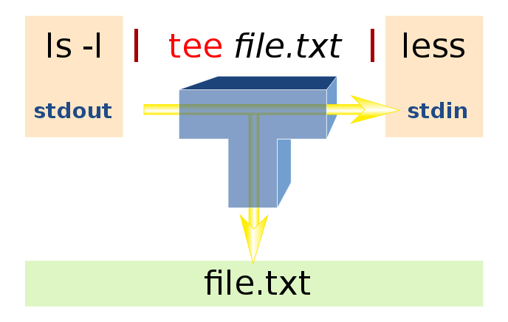
Linux tee Command
Unix-like Systems
tee [ -a ] [ -i ] [ File ... ] Arguments:
File One or more files that will receive the "tee-d" output.
Flags:
-a Appends the output to the end of File instead of writing over it.
-i Ignores interrupts.
The command returns the following exit values (exit status):
0 The standard input was successfully copied to all output files.
>0 An error occurred.

Slide 74
Building Spark Scala Project with sbt
We want to build a Spark application from file WordCount.scala residing in directory mini-examples/src/main/scala/edu/hu/examples
sbt also needs a file to tell it what to do.
That file is called build.sbt and in our case reads:
name := "mini-example"
# these empty lines are significantcd
version := "0.0.1"
# these empty lines are significant
scalaVersion := "2.10.4"
# these empty lines are significant
// additional libraries
libraryDependencies ++= Seq(
"org.apache.spark" %% "spark-core" % "1.1.0" % "provided")
To build Spark application from WordCount.scala type:
$ sbt clean package # in the directory containing build.sbt file
Build process created a bunch of directories. We are interested in the directory ../mini-example/target/scala-2.10. In that directory there appears a jar file mini-example_2.10-0.0.1.jar. That jar file contains our WordCount.class and will be distributed among members of the cluster if you have a cluster with more than one machine.

Slide 75
Run Scala version of WordCount
To run built project, in directory ../mini-example we type, all on one line:
$ spark-submit --class edu.hu.examples.WordCount ./target/scala-2.10/mini-example_2.10-0.0.1.jar ulysses/4300.txt scalacounts
If we examine HDFS directory scalacounts we will see a results file part-00000. We can copy that file to the local system
$ hadoop fs –get scalacounts/part-00000 scalacounts
And then see how are heavens doing this time
$ cd scalacounts
$ egrep –i heaven scalacounts/part-00000
(heaven,,8)
(Heavens_,1)
(heavenman.,1)
(heaven.,8)
(heaventree,1)
(heaven,17)
(heaventree,,1)
(heaven:,1)
(heaven's,1)
(heavenworld,1)
(heavenward.)_,1)
)
(heavens,5)
(heaven._,1)
(Heavenly,1)
(heavens,,1)
(heavenbeast,,1)
(heavenborn,1)
(heavenly,2)
(heaven!,1)
(heavenly.,1)
(heavengrot,,1)

Slide 76
WordCount in Python
You can do WordCounting in Python as well
file = sc.textFile("/user/cloudera/ulysses/4300.txt") counts = lines.flatMap(lambda line: line.split(" ")) \
.map(lambda word: (word, 1)).reduceByKey(lambda a, b: a +b)
>>> counts.saveAsTextFile("pycounts")
In HDFS directory pycounts you will find file part-00000 and part-00001

